Slide 1
2016 CARE Fair July 15th and 16th Horizonte Instruction & Training Center

Slide 2
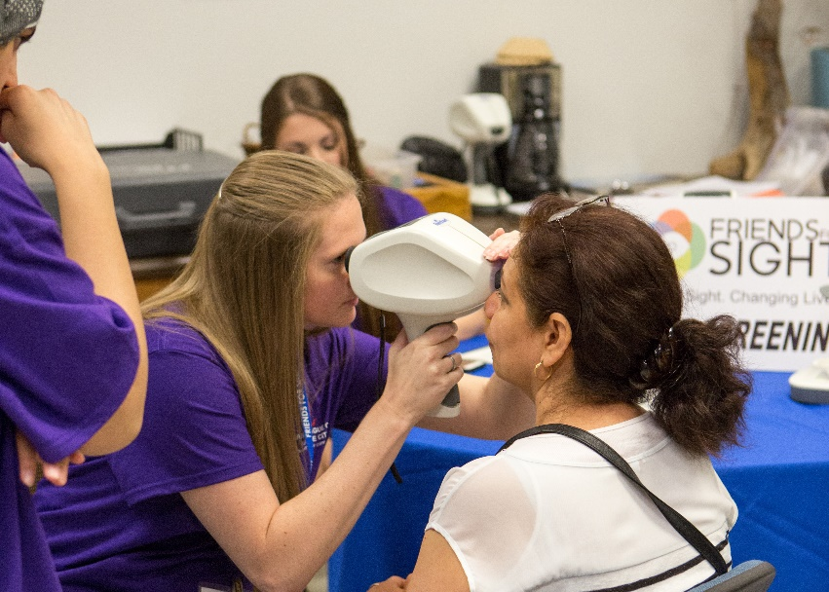
Medical Results
 | 2014 | 2015 | 2016
Physcial Exams & Vitals | 618 | 431 | 605
Immunizations | 81 | 32 | 165
Diabetes & Cholesterol Screenings | 465 | 250 | 270
A1c Tests |  | 69 | 125
Vision Screenings | 352 | 193 | 420
Glaucoma Testing | 287 | 162 | 209
Dietetic Counseling | 125 | 175 | 75
Dermatology Consults |  | 67 | 43
Hearing Screenings | 248 | 344 | 243
Mental Health Screenings | 61 | 68 | 112

Slide 3
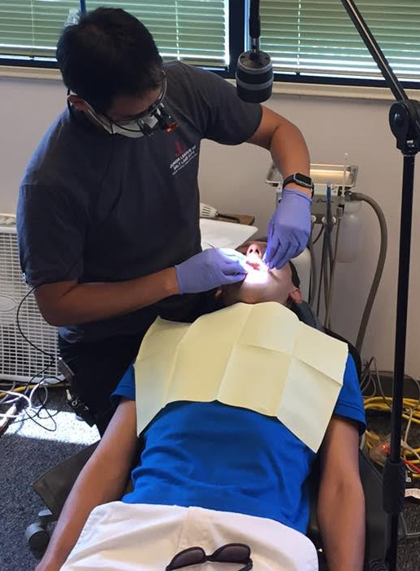
Dental Results
 | 2014 | 2015 | 2016
Dental Exams & Cleanings | 325 | 365 | 365
Dental Care Vouchers | 26 | 43 | 52
Fluoride Treatments | 325 | 340 | 365

Slide 4
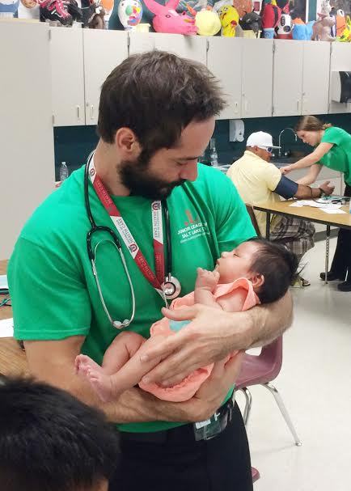
Women’s Services Results
 | 2014 | 2015 | 2016
Total Patients | 252 | 169 | 450
Gonorrhea Tests |  |  | 62
HPV Tests | 61 | 95 | 157
Postive HPV Results |  |  | 10
Chlamydia Tests |  |  | 62
Positive Chlamydia Results |  |  | 2
Pap & Pelvic Exams | 134 | 170 | 450
Pap Tests |  | 95 | 157
Mammogram Screenings | 129 | 100 | 188
Diagnostic Mammograms | 36 | 12 | 18

Slide 5
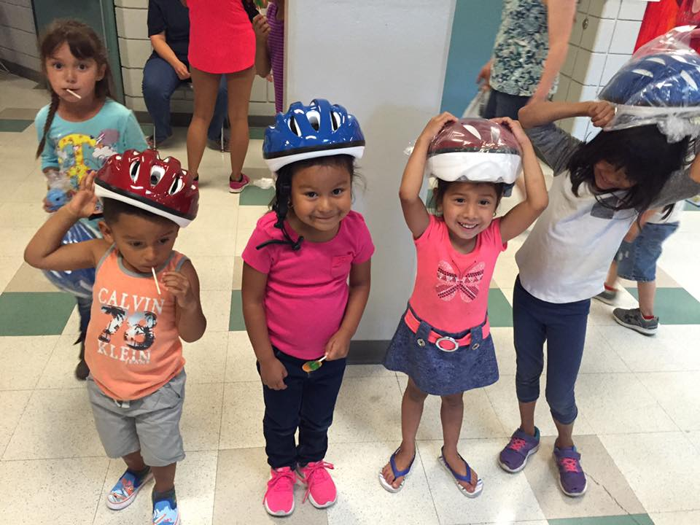
Agency / Day Care Results
 | 2014 | 2015 | 2016
Agencies Attended | 15 | 16 | 13
Bike Helmets Distributed | 300 | 280 | 245
Car Seats Distributed | 260 | 238 | 309
Children in Day Care | 500 | 173 | 216

Slide 6
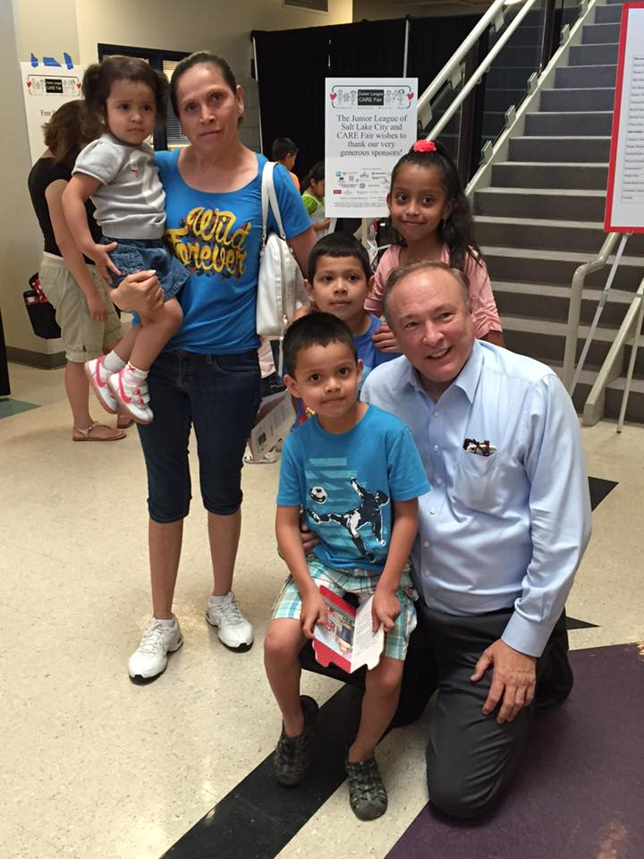
Demographic Data
 | 2016
Clients Served Adults Children | 3091 1884 1207
Female Male | 68.9% 31.1%
Insured Uninsured | 17.5% 82.5%
Medicaid | 29.2%
Ethnicity Hispanic/Latino Pacific Islander Black/African American Native American White Asian | 70.8% .9% 2.8% 3.8% 16% 1.9%

Slide 7
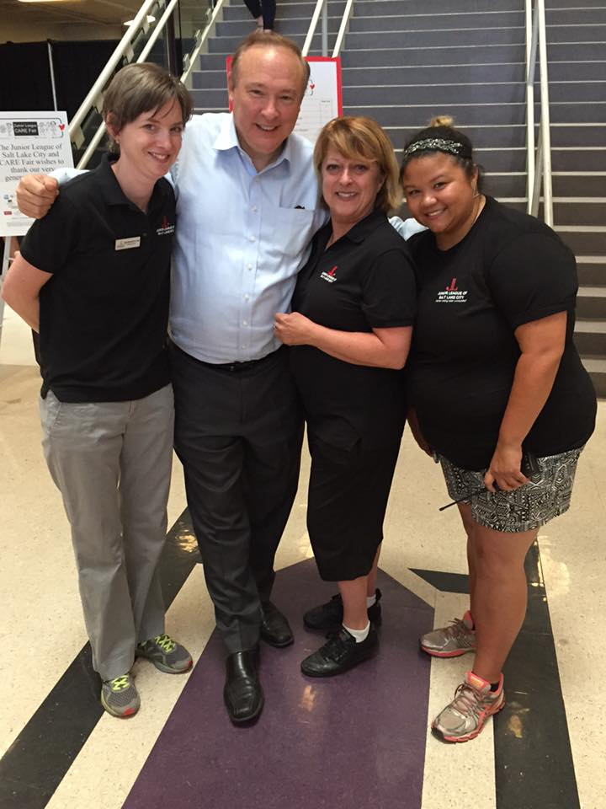
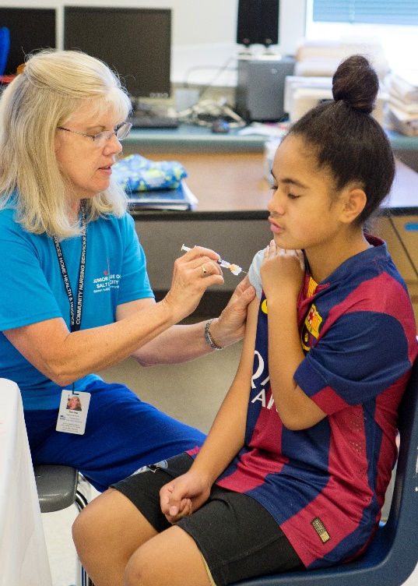
THANK YOU TO ALL OF OUR VOLUNTEERS & COMMUNITY SUPPORT!
2016 CARE Fair Director – Brenda Mateos
2016 CARE Fair Committee
Shannon Dunlop
Jeni Fitzgibbon
Courtney Hutchinson
Stephanie Parsons
Kate Trimble
Julie Van
Chanda Jenkins

